Slide 1
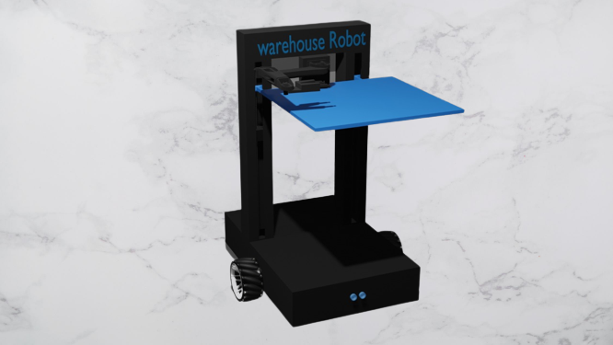
Warehouse Robot
An Autonomous Electrified Cargo Shipping Robot

Slide 2
Introduction: Warehouse robotics
Warehouse robotics is an umbrella term used to refer to the usage of robots, automated systems, and other complex software systems in tandem with the Warehouse Management Systems (WMS) to automate and streamline warehouse processes.
It has been gaining prominence over the past decade owing to reduced costs of ownership, increased demand for cost-effective & high-throughput warehouses.

Slide 3
Warehouse robots are the most effective replacement to minimize the pressure and availability of manual labor. They are mainly used for heavy lifting, picking up packages, transporting, and other tasks in the facility. They require little space, provide flexibility in managing varying demand requirements, and can work 24/7.
This makes them particularly fit for e-commerce operations. The growing market of Internet of Things, Artificial Intelligence, and machine learning in the warehouse industry is forecasted to grow in the robot market soon.

Slide 4
Warehouse Robot
an integration of two technologies: the combination of AGV (Automated Guided Vehicle) and Robotic Arm technologies.
AGVs: offer more flexibility compared to AS/RS (Automated Storage and Retrieval System) for material transport. AVGs navigate by following a series of simple commands guided by strips, QR codes or wires. Which require facility updates to install and maintain. They are constrained to only follow the paths laid out by the guiding infrastructure.

Slide 5
The robotic arm: used in this project is fitted with sensors for object identification and a special purpose gripper (air compressor) to perform the picking and fitting processes of the merchandise.
A mobile app and a website for the warehouse are made which allow the client to easily select and buy their desired products online with two online payment gateways.
The two UIs are quite identical and easy to use providing smooth and consistent graphic interface and excellent scalability for developers for further product additions.
The Human factor is only required for monitoring the main process, developing the software. The whole process is automated and only requires minimal human interference in monitoring and maintenance only.

Slide 6
Initial Market Segmentation
According to ARS (Amazon Robotic Service) market research identified the Global Robotics market segmented by robot type, function, end-users, and geography as shown in the picture. The type of robots is classified into SCARA, cylindrical, parallel, mobile, cartesian, and stationery articulated robots.
Among these robot types, mobile robots are most popularly used in 2017, followed by articulated robots.
The most used function by warehouse robotics is the pick & place, followed by packaging.

Slide 7
Based on the end-users' perspective, the warehouse robotics market is segmented into e-commerce, automotive, food & beverages, electronics & electrical, metal, pharmaceuticals, and others. Among these, the E-commerce industry uses the most warehouse robots, followed by the automotive industry.

Slide 8
Market Need
COVID-19 changed the customer purchase behavior, and the customers are now inclined more towards online ordering. This trend has pushed retailers to compete to provide better customer service. Better customer service would demand more inventory transparency, quick delivery cycles, etc. Online retail sales increased 32.4% year over year in 2020 and are up 39% in Q1 2021.

Slide 9
Market Trend
To meet ever-growing customer expectations and improve operational efficiencies, retailer and e-commerce companies are looking towards Autonomous Mobile Robots (AMRs).
These robots are used to pick, transport, and sort items within the distribution facilities without any manual intervention. The AMRs leverage the vision cameras, sensors, integrated warehouse maps, and execution software system to perform various operations.

Slide 10
AMRs are used in cases where strenuous movements of goods were needed. This strategy helps to prevent injuries and promote warehouse safety for workers.

Slide 11
Market Opportunity
Total Available Market: The global autonomous mobile robots market size was valued at USD 29.3 billion in 2019, and the market size is expected to reach $220.6 billion at a compound annual growth rate (CAGR)of 18.3% from 2020 to 2030 across all industries like logistics, healthcare, manufacturing, military, mining, etc.

Slide 12
Target Customers
Service Available Market: The Warehouse robotics market is approximately worth $4.6 billion globally in 2021. The North American autonomous mobile robot market is expected to reach $25.14 billion in 2025, growing by 12.6% annually over the forecast years.
Customers started to view warehouse technologies as necessary investments to achieve operational goals and meet customer demand on time. Warehouse automation is a space to thrive in the coming years, and there is a good market demand for the right solutions. Some of the customers that should be targeted for providing the mobile robots includes customers from the following industries:
Logistics, E-commerce, Warehousing, AMRs and Mobile Manipulators for Manufacturing, Data Centers, Healthcare.

Slide 13
Warehouse robotics: Benefits
Scalability: Warehouses are either understaffed and struggle to meet the demands or are overstaffed with an unhealthy cost-per-order ratio. Robots enable warehouses to scale efficiently with ups and downs of the market tide.
Improved Accuracy: Most warehouses today use manual processes for picking and order fulfilment. This usually leads to unacceptable picking error rates (as high as 10% in some cases), causing customer dissatisfaction and reverse logistics costs compound overtime. Warehouse robots are precision machines with picking accuracy of ~99.7%.

Slide 14
High throughput: One of the greatest advantages of automation or robotics is the ability of these machines to do menial, repetitive tasks continuously, 24/7, without fatigue or reduction in throughput.
In contrast, most warehouse associates spend 70-75% of their time travelling between tasks (10-15 miles per day), which does not add any net value to the output. AMRs alone can increase the productivity of the workforce in a warehouse by 3x.
Warehouse robotics solutions when employed correctly, increase throughput of the warehouse and lead to better space utilization.

Slide 15
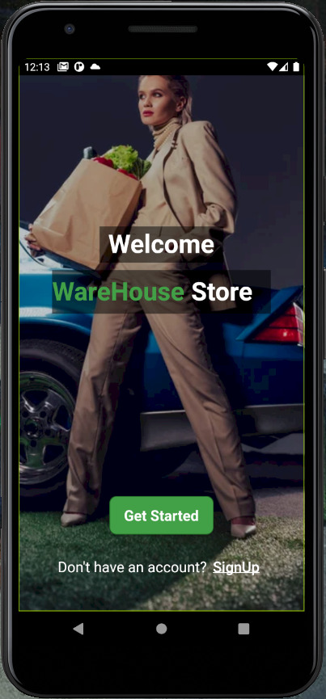
Warehouse application
The Warehouse Store Application is specifically designed to control the interaction between the user and the Robot in an easy and very simple way without any human intervention.
.

Slide 16
Three ways to use the application
1- E-commerce application that offers online shopping experience which the market needs due to the urgent situation we live in right now. Examples: Amazon, Jumia, souq. (From Shops To Client)
2 – Modern technology added to the offline shopping experience where offline shops don’t need workers anymore. It saves effort, time and a lot of problems. (From Client To Shops)
3- Warehouse Experience where the application connected to the robot performs the whole process (From Warehouses To Client)
And that’s today’s topic…

Slide 17
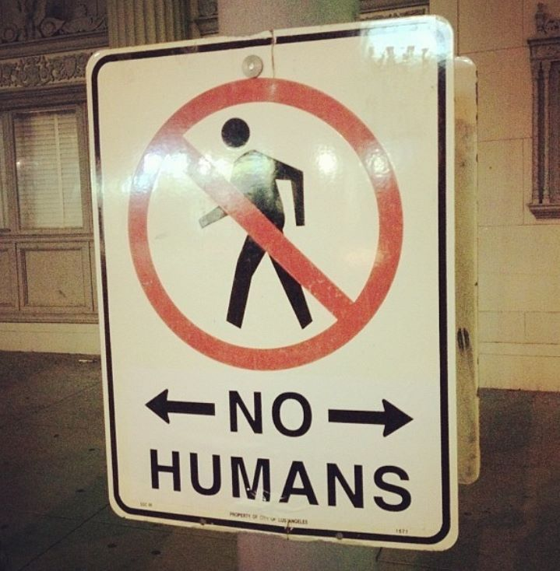
(From Warehouses To Client) the two element process:
Instead of (Warehouse> Shop> Client) = Long Process And High Waste
We introduce THE TWO ELEMENT PROCESS:
From Warehouses to Client directly.
No Human intervention in The Storing process
No Human intervention in The Shopping process
You only see humans when you receive your favorite products 😉

Slide 18
How the application works
The Application is based on the E-Commerce Experience, and it works as the following:
The user navigates the application to find the products he/she needs.
The user then chooses the desired products and requests them from the application
After deciding the appropriate way of payment and filling in the personal details of the user such as the name, address and the phone number.
The application sends the request to the Back-End administration and communicates with the database server.
Then finally a request is sent to the robot to get the requested products from the warehouse and deliver them to the Goods Stand in order to be ready for delivery.

Slide 19

Flutter Technology
The Programing language used in the application is DART programing language using FLUTTER framework.
DART is a programming language designed for client development such as for the web and mobile apps.
It is developed by Google in May 2017 and can also be used to build servers and desktop applications.

Slide 20

Flutter is an open-source, cross-platform toolkit used for building apps for mobile OS, web, and desktop with the same code base. That means developers write code once and apply it to all the platforms – iOS, Android, web platform, macOS (Windows and Linux are still under development), and even Wear OS.

Slide 21

Cross-platform Advantage
iOS: Swift and Objective-C
Android: Java and Kotlin

Slide 22
User Verification
User Identity Verification is a security measure that verifies that all requests made from within your app are coming from authentic end users.
This ensures that 3rd parties cannot perform malicious actions, such as filing Issues on behalf of your users, or updating their personal information.

Slide 23

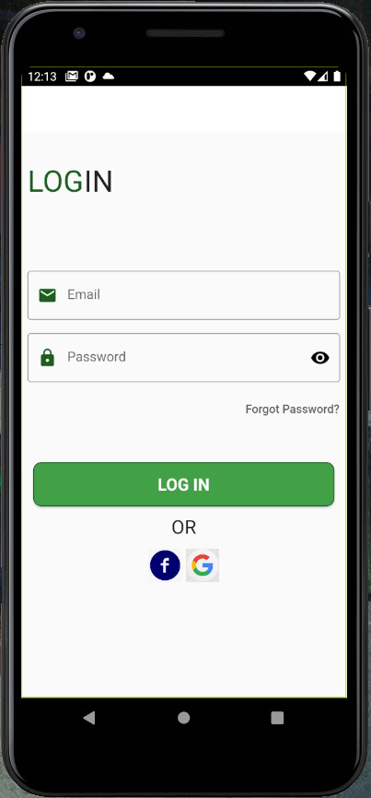
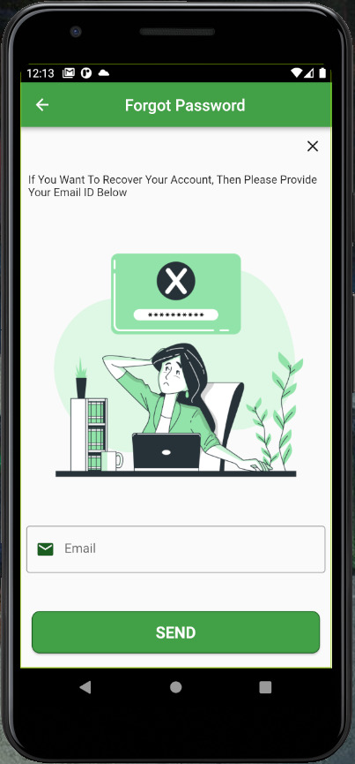

Slide 24
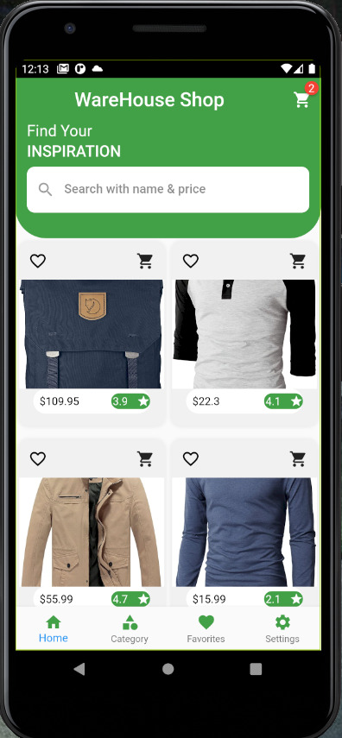
UI Interface And Design
User interface (UI) design is the design of user interfaces for machines and software, such as computers, home appliances, mobile devices, and other electronic devices, with the focus on maximizing usability and the user experience.

Slide 25
Image Processing
Image processing is an algorithm to detect and decode visual code lines and QR codes in medium resolution images is presented. The algorithm uses adaptive methods to segment the image to identify objects.

Slide 26


QR DETECTION WITH Angle-Calculator
The algorithm is implemented almost entirely in Python and utilizes the OpenCV image processing/computer vision library. The algorithm can be compiled to run as standalone. The source files include a 200- line Python file. Figure 18 shows some of the major steps in the algorithm.

Slide 27
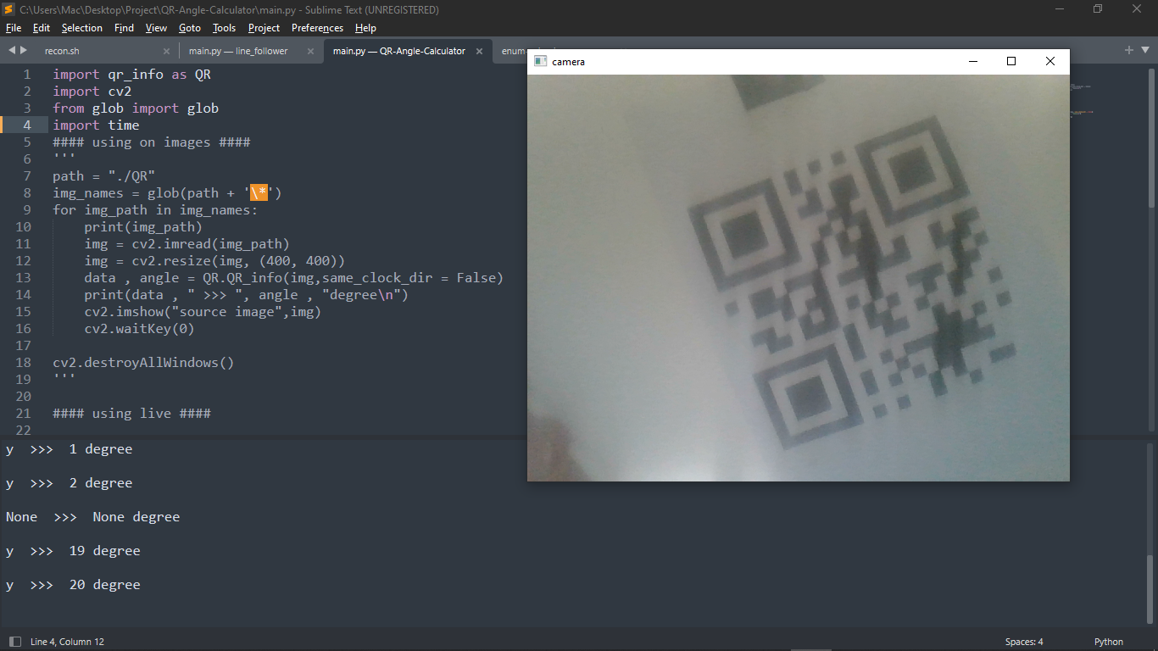

Slide 28
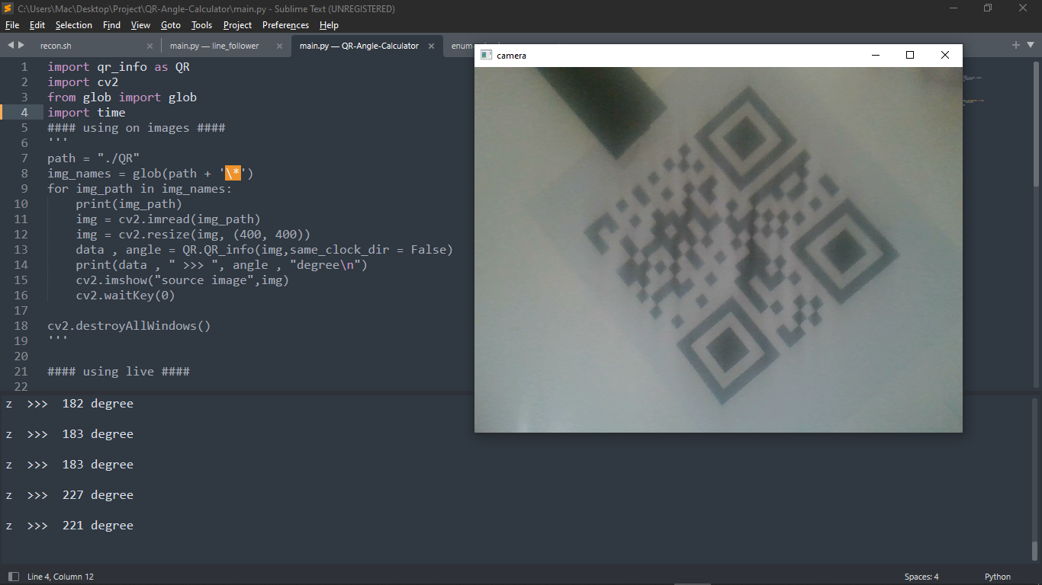

Slide 29
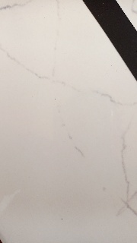

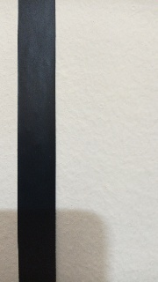
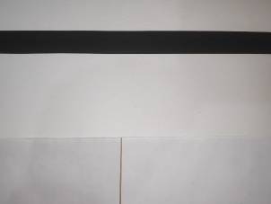
line_follower
The development of the algorithm is based on the idea that the guide bar pair is the key element that can be used to identify marker candidates in an image. Once potential guide bar pairs are identified the incorrect candidates can be filtered out by looking at other characteristics of the marker.

Slide 30
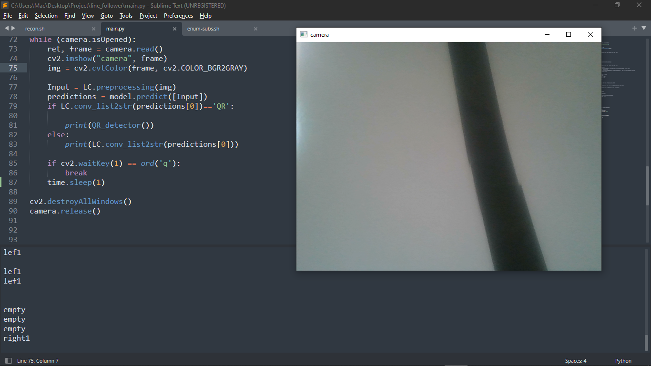

Slide 31
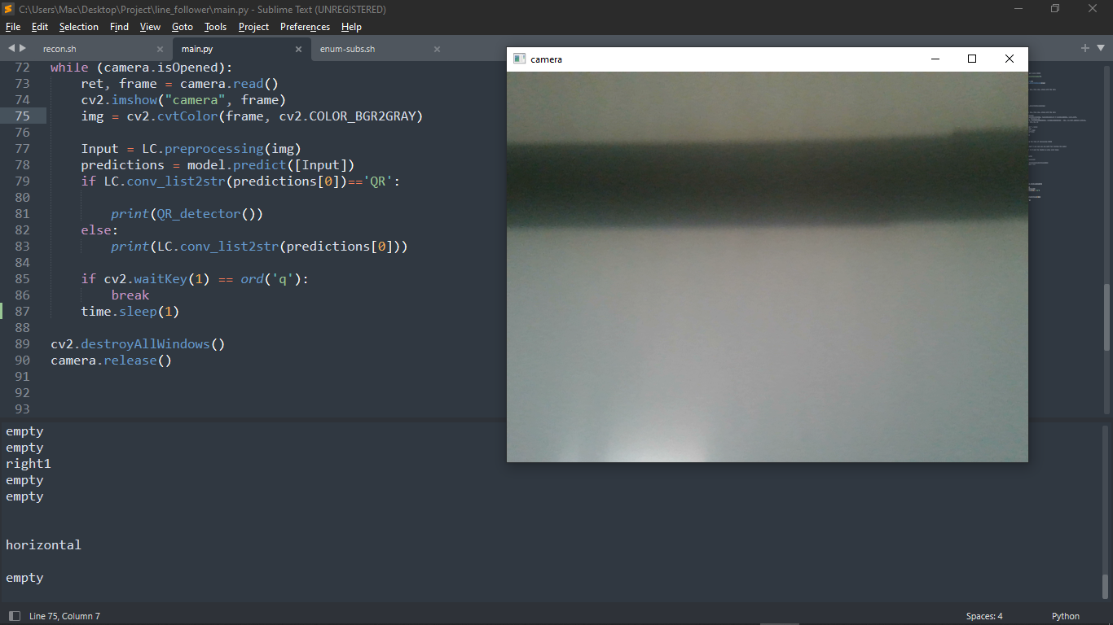

Slide 32
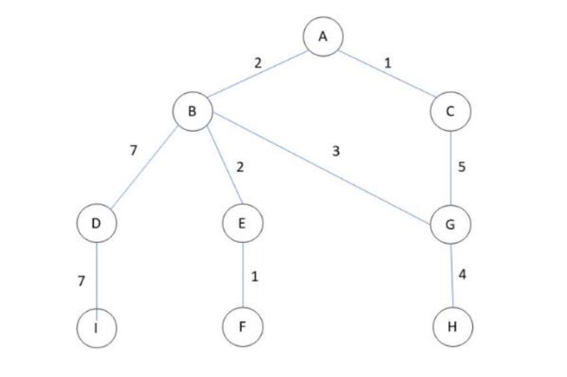
search_tree
The algorithm is implemented almost entirely in Python and utilizes a Sorting algorithm. The algorithm can be compiled to run as standalone. The source files include a 130-line Python file. Figure 20 shows some of the major steps in the algorithm.

Slide 33
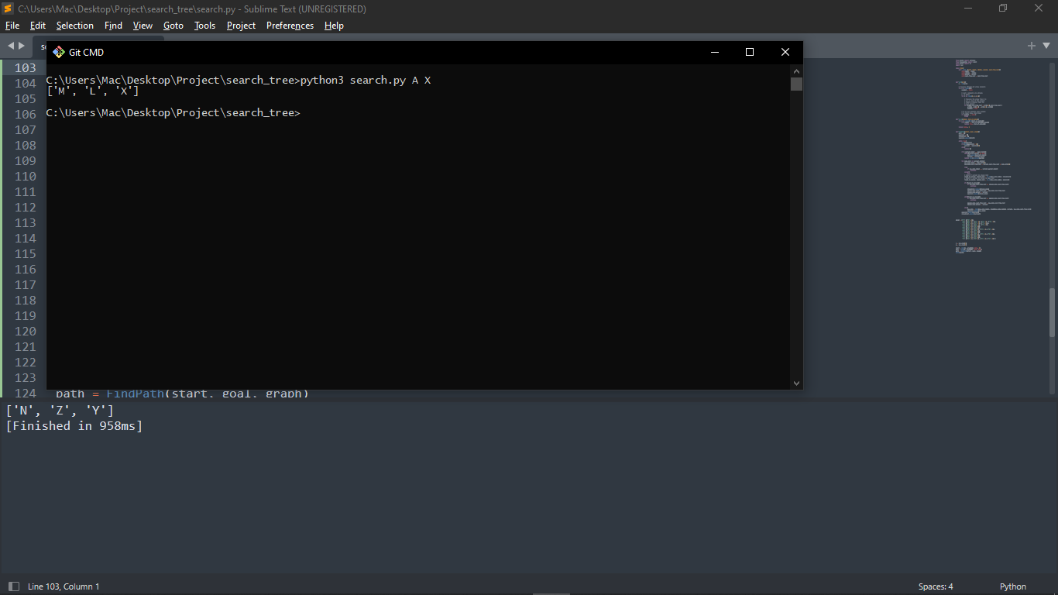

Slide 34


Slide 35
Main Rule
the robot is always connected to a website and mobile app to display the products available in the stores.
When the customer requests certain products and their request has been confirmed, the robot will automatically move these products out of the warehouse to the place to be transferred.

Slide 36
How it works
The robot follows the algorithm of Searching technique that enable it to identify the location of the product and the proper path.
Now in order for the robot to move, it must see the path from the starting point to the end point, so we have done high image processing and good training for the model so that it can determine the difference between the paths , read QR and by this the appropriate commands for the movement is decided.
When the robot reach to the desired location it starts the required implementation process and then return to the place of shipment.

Slide 37
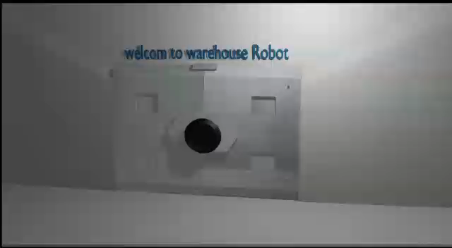
demo

Slide 38
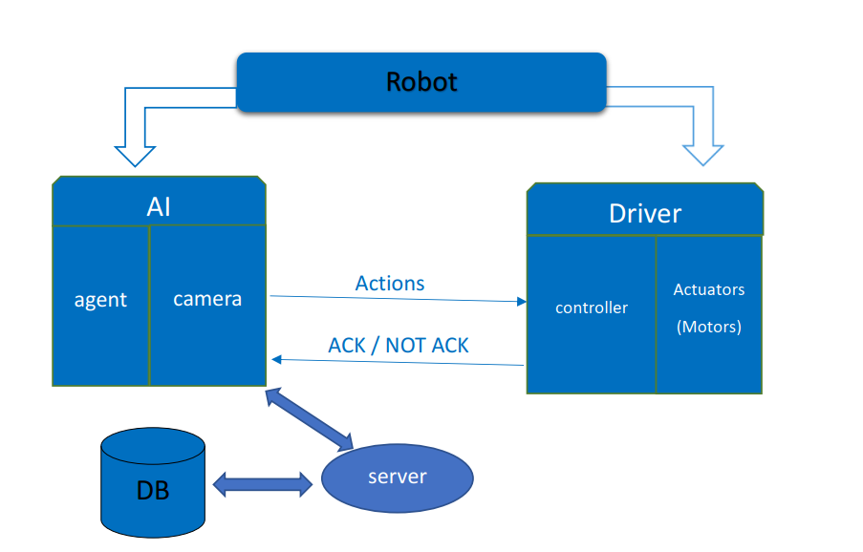
ROBOT Map

Slide 39
ROBOT manufacturing and programing
Hardware components :
The Structure and Body
Motors
Camera and Sensors
The Battery
The Controller

Slide 40
The Structure and Body
General shape
It is a rectangular base “45*50cm” with two vertical axes attached”100cm”
, fixed plate and ARM.
Manipulator items :
wheels: two wheels with 130mm diameter and one free with 30mm diameter.
To facilitate the rotation of the robot and its accuracy, we used two wheels in the middle of the robot and one free wheel in the middle end of the robot .

Slide 41
Manipulator items :
Axles : We used two axes to move the fixed surface up or down instead of using one axle. This makes the robot carry heavier weights, but we must take care that we must move them together to the same degree and at the same moment.
Arm : Consist of two links , three nodes and the end effector.
what we need from this arm is this to move the end effector of the arm in a straight line back and forth.
In order to keep the end effector in a certain direction, if one of the two links moves at a certain angle, the end effector must move at the same angle in the opposite direction.
if two then sum , if two in opposite with the same angle then the middle

Slide 42
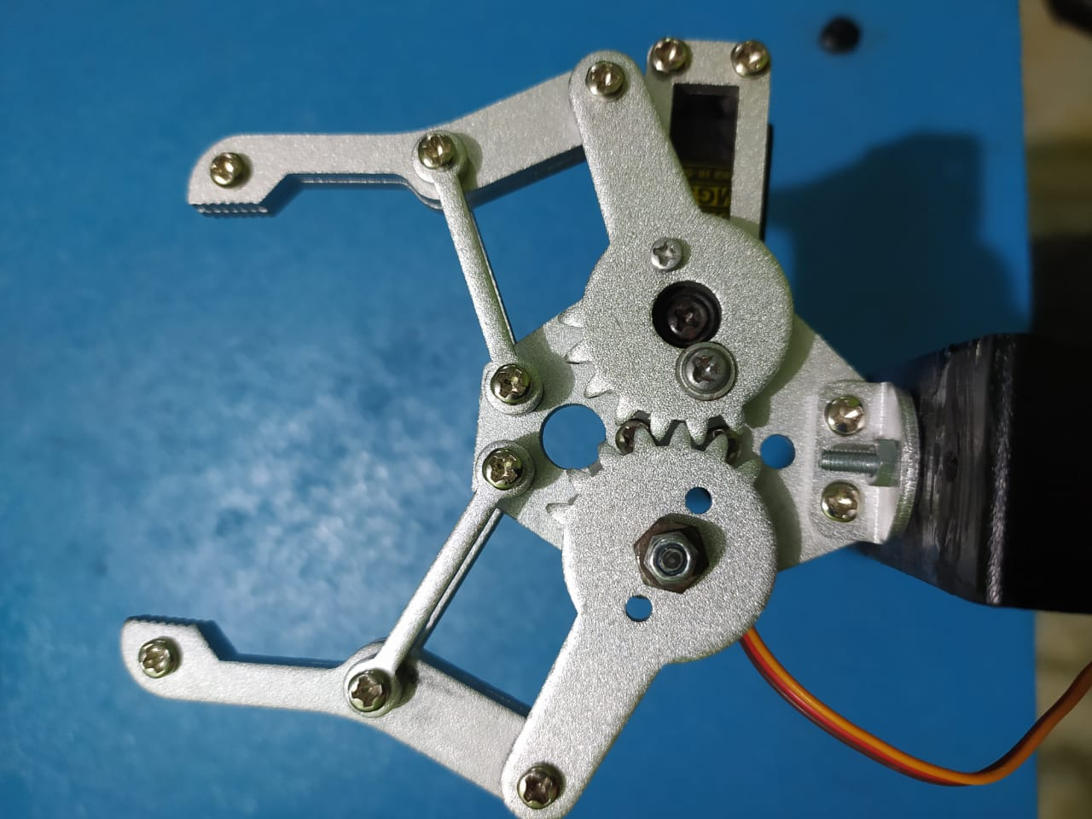
End effector : hand
The Material :
The material that the frame is made of is wood as it is cheaper and easier to manufacture
Robot weight: Approx. 24 kg
Dimension : 45 cm length * 50 cm width
Height 120 cm.

Slide 43
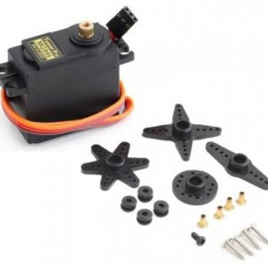
Motors and drivers
Servo: This motor is used for arm movement we use “servo MG995”.
How it works : by varying the width of the PWM signal, we can change the rotation angle and direction of the motor.
this degree of rotation can be controlled by applying a logic level 1 pulse for duration between 1ms to 2ms every 20ms .

Slide 44
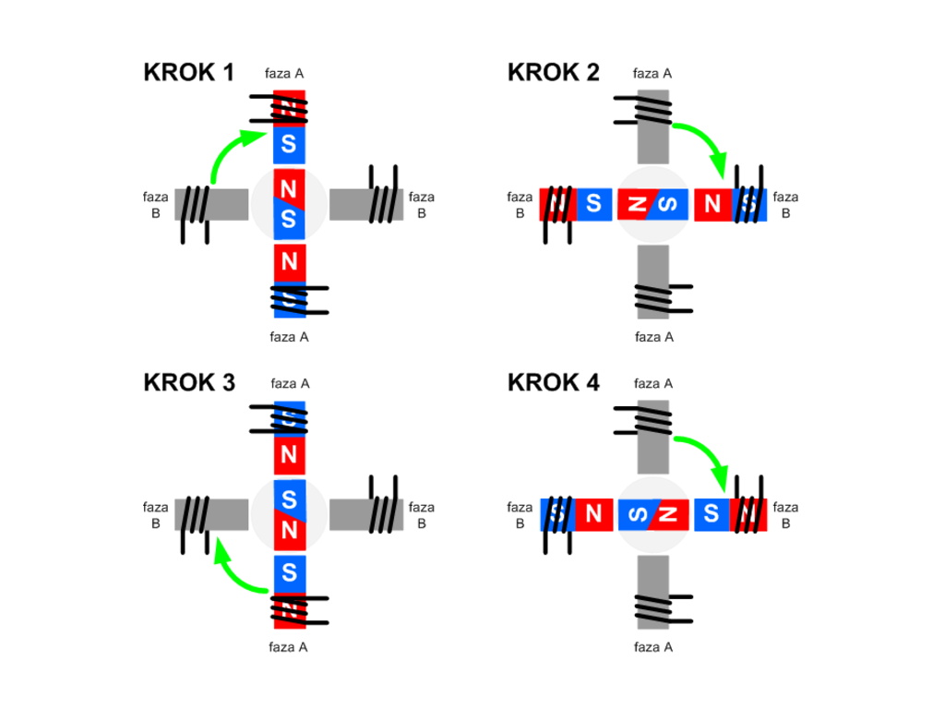
Stepper : This motor is used for movement of the surface installed on the axles we use Stepper motor “Nema 23”.
How it works : The stepper motor consists of a rotor that is generally a permanent magnet and it is surrounded by the windings of the stator.
As we activate the windings step by step in a particular order and let a current flow through them they will magnetize the stator and make electromagnetic poles respectively that will
cause propulsion to the motor.
So that’ the basic working principle of
the stepper motors.

Slide 45
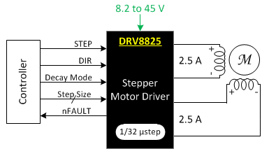
Used Driver : we use TB67S109AFTGStepperMotorDriver.
TB67S109AFTG is 2nd generation micro-step stepping motor driver. It has micro-stepping capability up to 1/32. It has low vibration and high efficiency and low heat generation. Suitable for drive stepping motor dynamic voltage 9V to 40V, the maximum drive current is less than 4A.

Slide 46
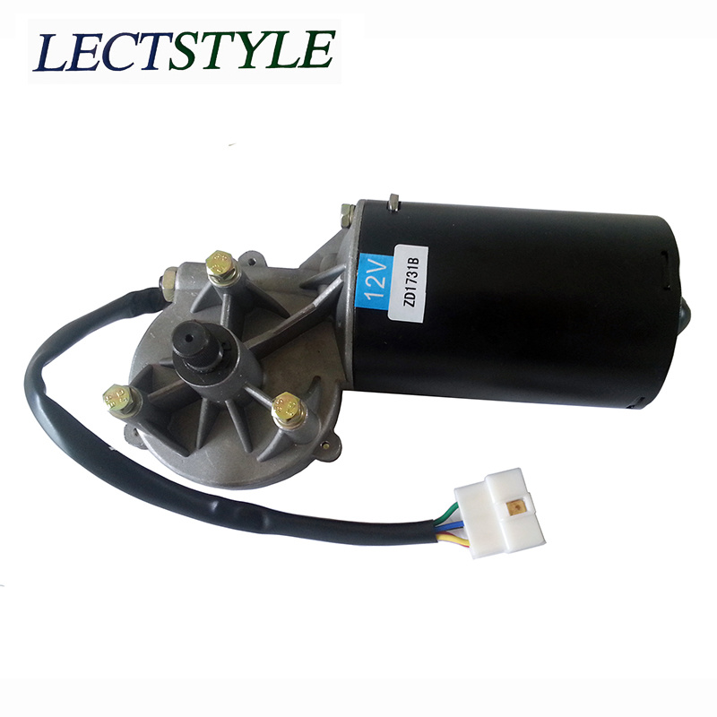
Motors and drivers
DC Motor: This motor is used for wheels movement.
we are used this motor it’s about dc motor and gear box.
How it works : the rotator is go on when we generalize different signal and proper Voltage on its two poles.

Slide 47
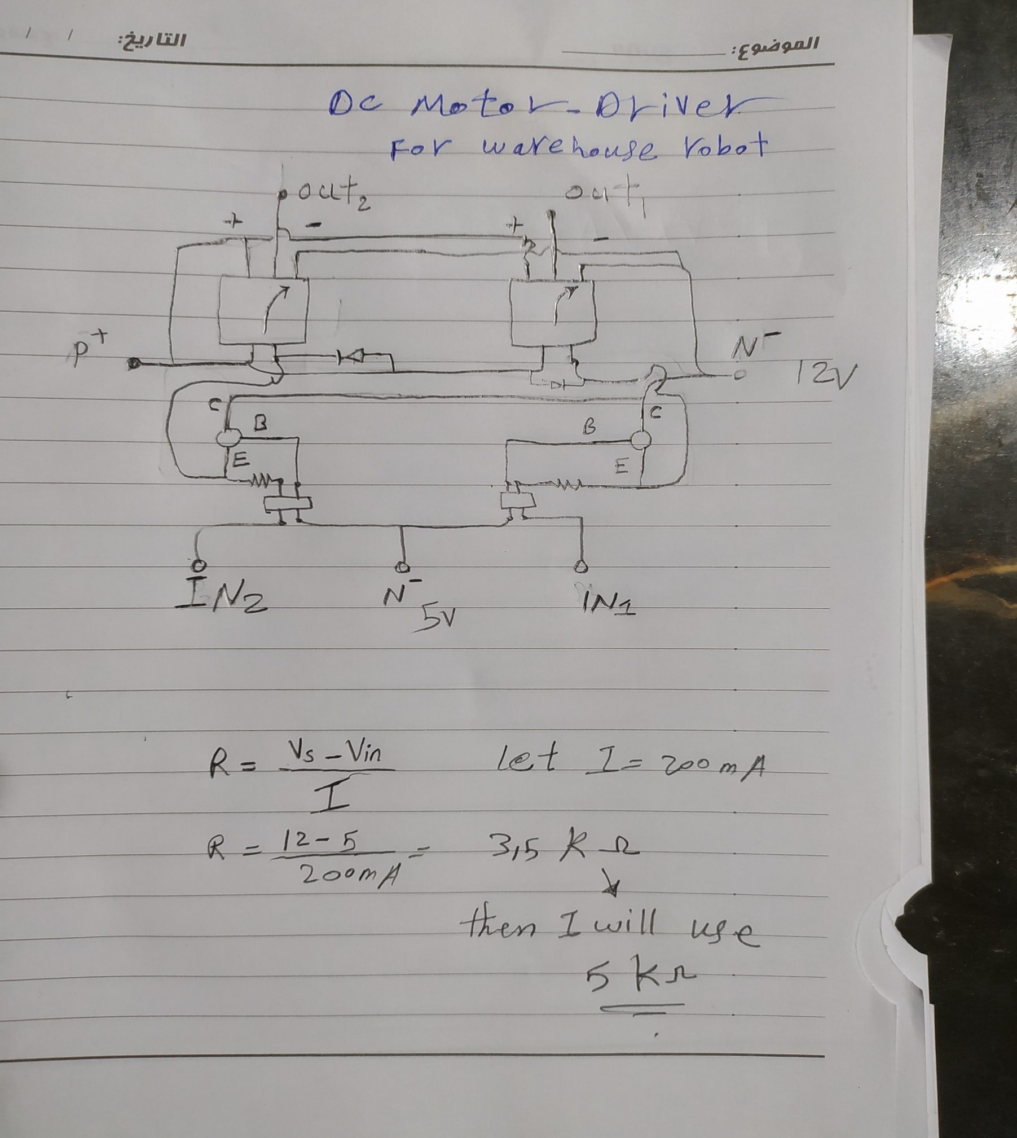
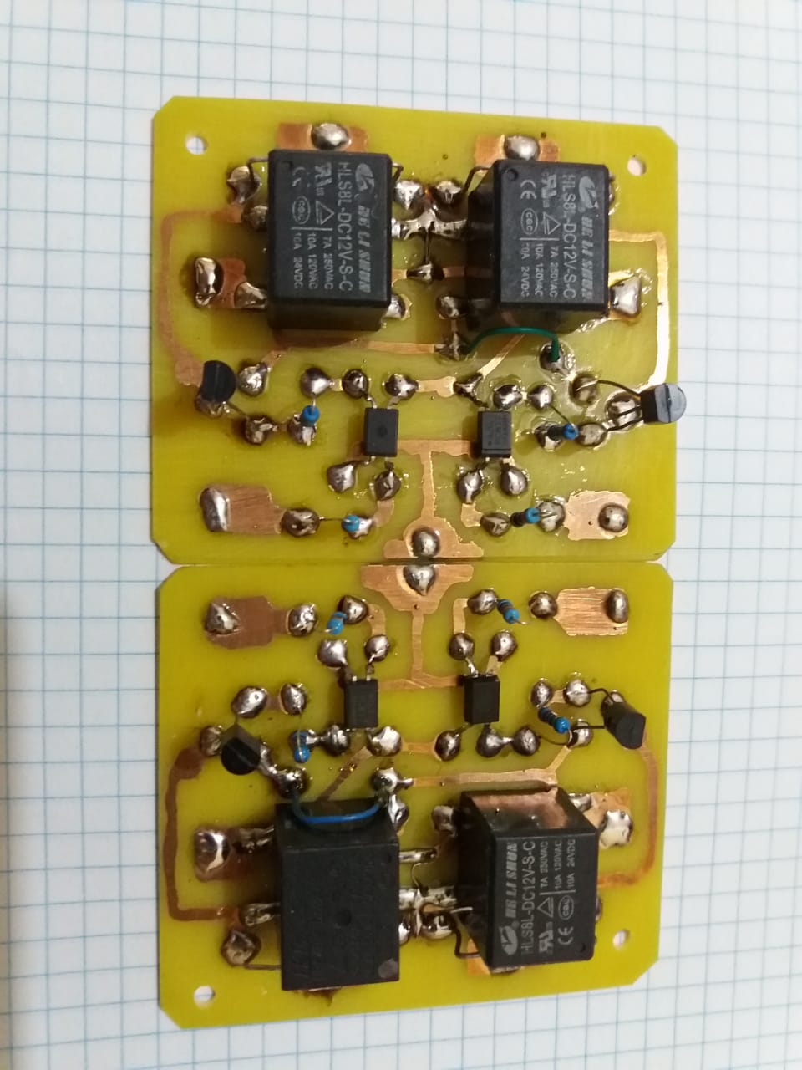
Used driver : We designed the appropriate driver for this motor due
to a high current draw.

Slide 48
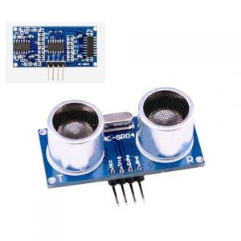
Camera and Sensors
The camera : is used to see the path. Without it, the robot cannot move because it does not see anything ”raspberry pi Camera Model 5Mp”.
Ultrasonic sensor : is used for prevent the robot from acceding to any thing appear suddenly front of it .
How it work : it send sound signal and set time at the same time when it receive that signal we have the all time from arise to return back and there for we can measure the distance from
distance = (T/2)*0.03429 CM

Slide 49
The Battery
The battery used is a 12V rechargeable battery with a capacity
of 12000ma per hour .
This mean robot will run for 0.5 hours.

Slide 50
The Controller
Raspberry pi : raspberry pi model 4 RAM 2
To perform many actions, read files, update the database, read data from sensors and perform image processing, we needed a GPU, DSP
Arduino : mega 2560
this controller receives a signal from Ras then performs operations accordingly, and sends signals to the Drivers to perform the required function.

Slide 51
software / Programming
LINK: https://github.com/Mohamed-FaryedAhmed/Warehouse_Robot.git

